Slide 1
WE761 Exercise 2 Review
CLI
XMI (SOMA / AMP)
RMI

Slide 2
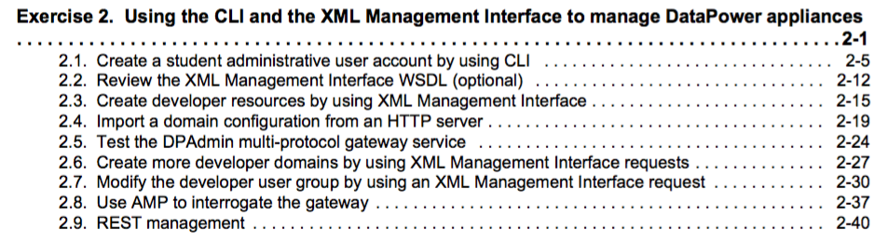
Exercise 2 - Agenda
Important sections:
2.1 - CLI
2.3, 2.6, 2.7 - XMI (SOMA)
2.8 - XMI (AMP)
2.9 - RMI
Elaborate:
2.4, 2.5 - DPAdmin service
(worth looking at the processing
policy and its actions)

Slide 3
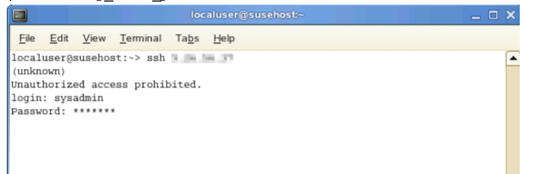
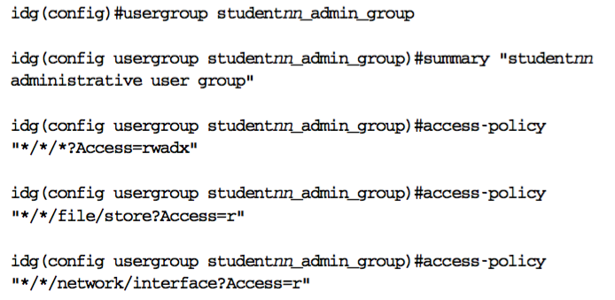
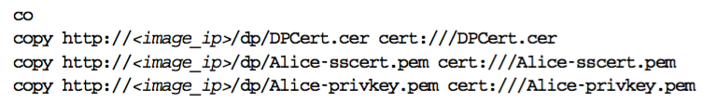
CLI – SSH from Terminal Window

Slide 4
XMI Direct – Message Flow
Workstation
IDG
default domain
Program:
- cURL, Java, Ant, Perl, …
XMI (SOMA & AMP) – 5550
RMI - 5554

Slide 5
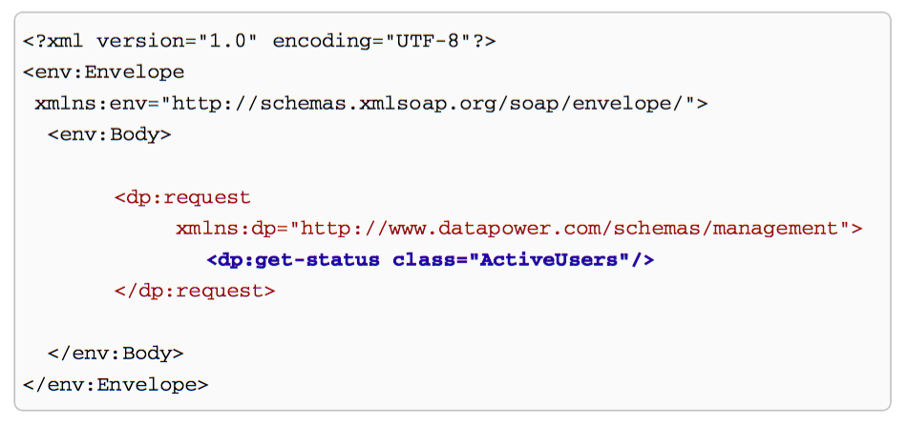
XMI Direct – SOMA Structure
A simple example taken from the notes

Slide 6
XMI – Exercise Sections 2.4, 2.5
An elaborate architecture!!!
Web page from some server:
takes form data
form data sent to by JavaScript to a server, address determined by some of the form data
Server is DPAdmin MPGW on IDG
DPAdmin:
extracts form data, converting to XML
sets route to back end (XMI on some IDG)
converts the XML into SOMA
sends to back end (XMI on some IDG)

Slide 7
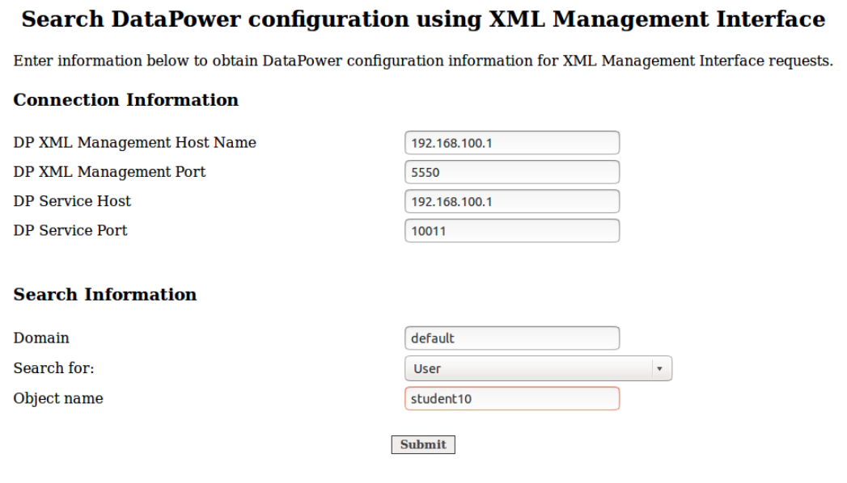
XMI – Exercise Sections 2.4, 2.5
Workstation
IDG
student01_domain domain
Web page with JavaScript
DPAdmin (MPGW)
default domain
XMI (SOMA & AMP) – 5550
RMI - 5554

Slide 8
Web Page
DP Service Host, Port
- used by JavaScript to target DPAdmin
DP XML Management Host, Port, Domain, Search for, Object name
- sent as form data to DPAdmin

Slide 9
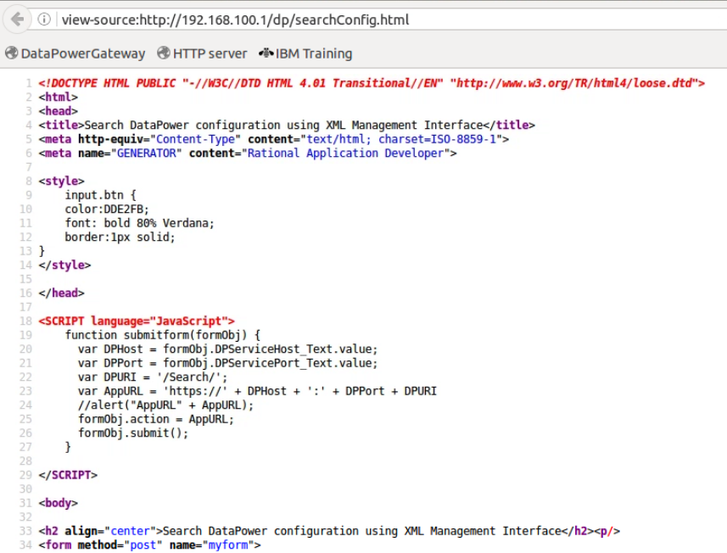
JavaScript in Web Page - 1

Slide 10
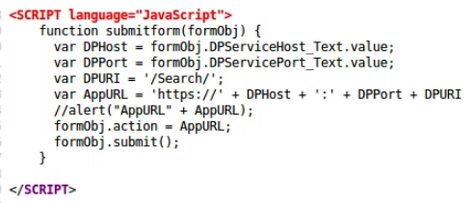
JavaScript in Web Page - 2
The web page could have been served
up from anywhere, just happens to be
Apache http server on Linux workstation
On clicking Submit button sends form data to DPAdmin

Slide 11
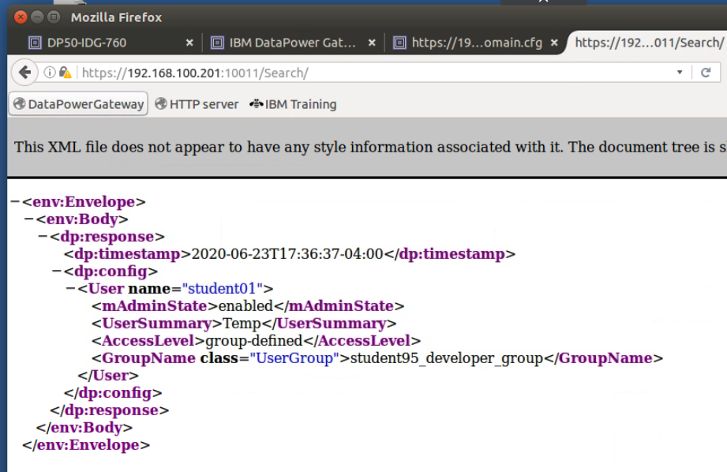
SOMA Response via DPAdmin

Slide 12
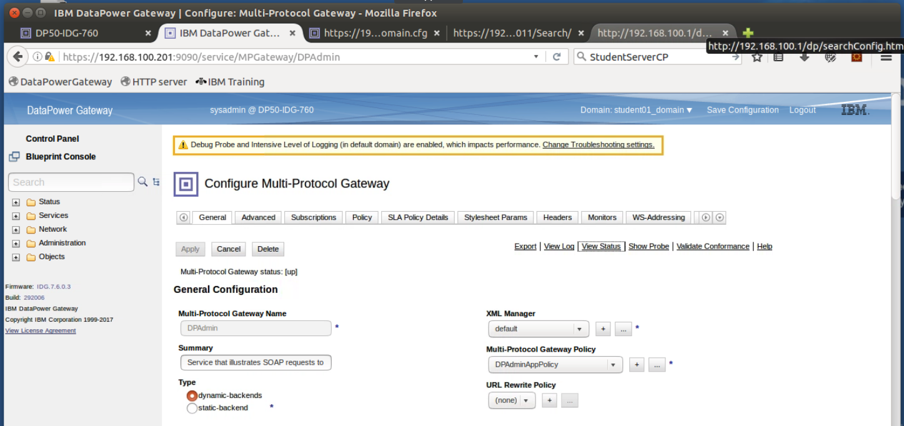
DPAdmin in student01-domain
Built by a competent DataPower developer to provide
advanced DP admin capabilities?

Slide 13
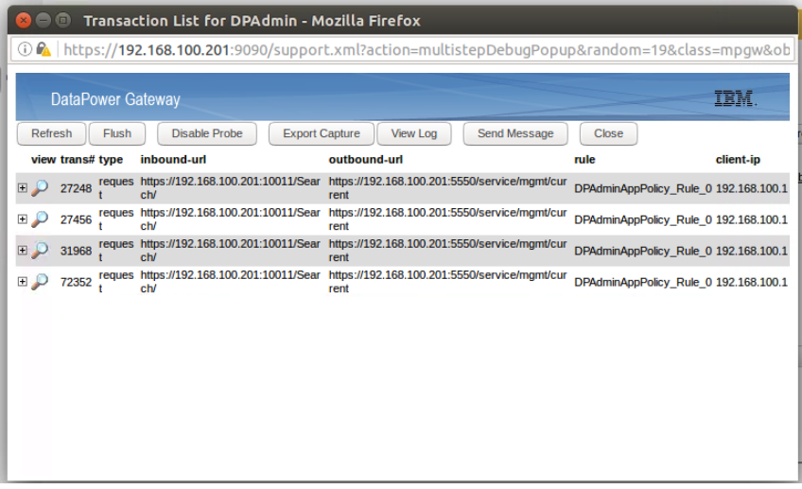
DPAdmin probe

Slide 14
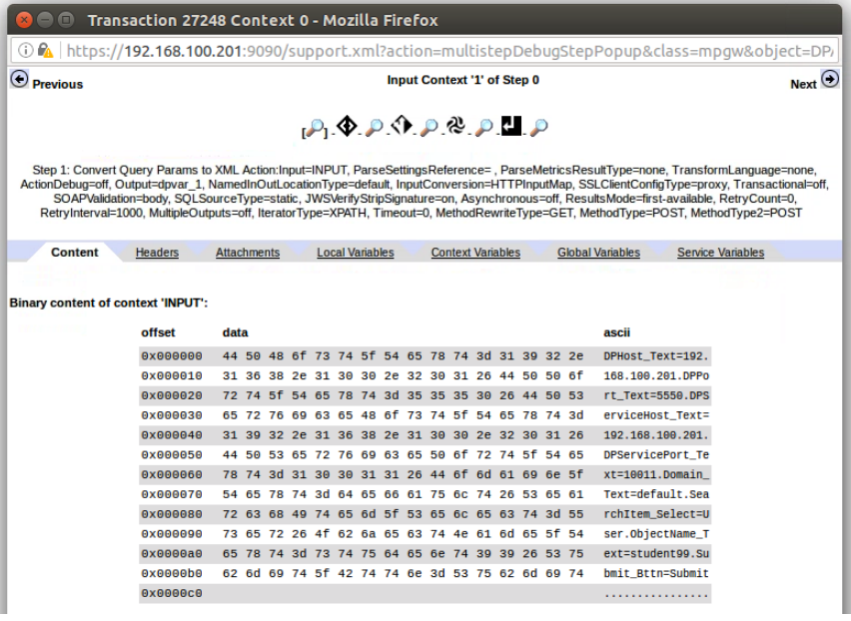
DPAdmin - INPUT context

Slide 15
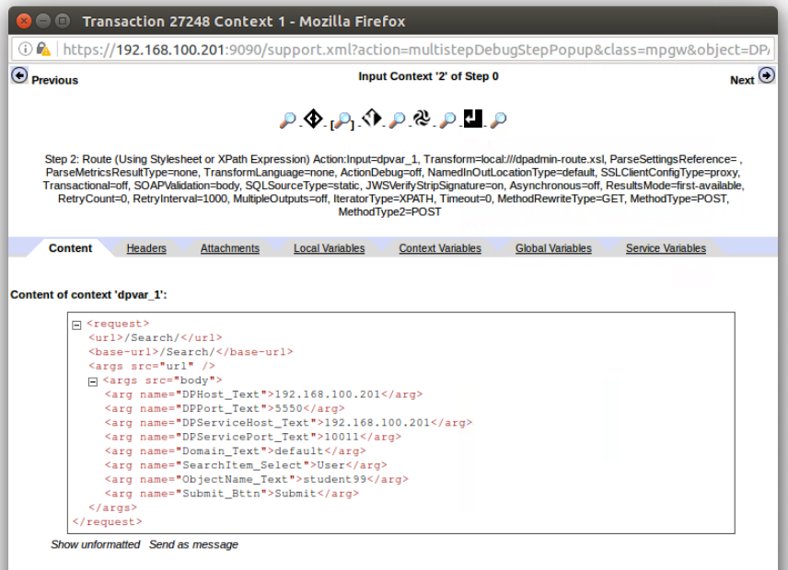
Action Convert Query Params to XML

Slide 16
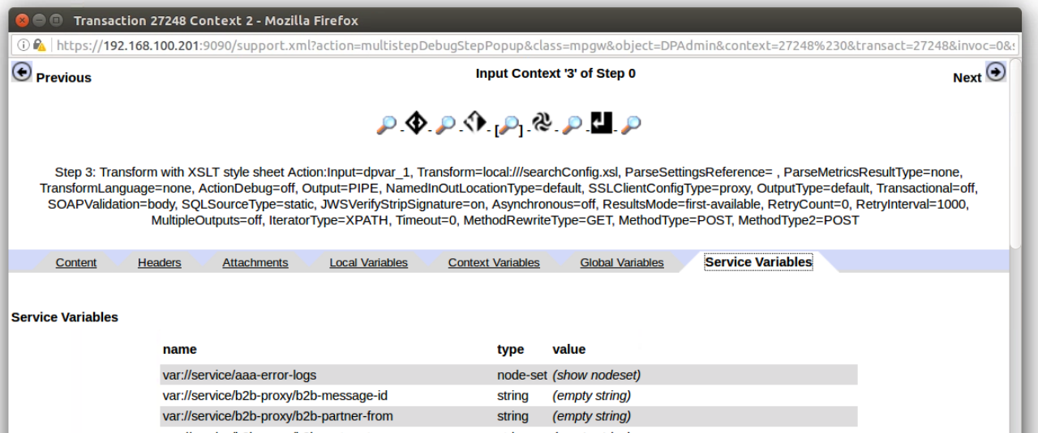
Action: Route
Sets a Service Variable

Slide 17
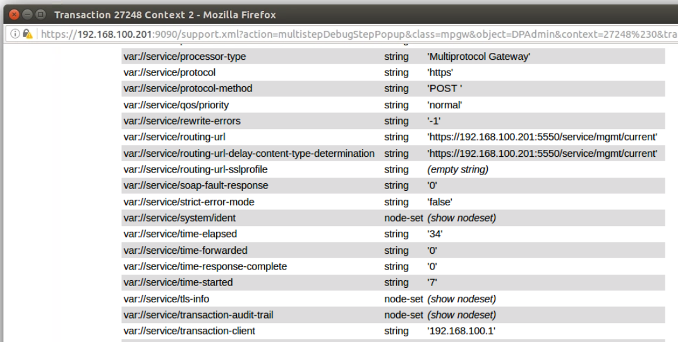
Action: Route
var://service/routing-url

Slide 18
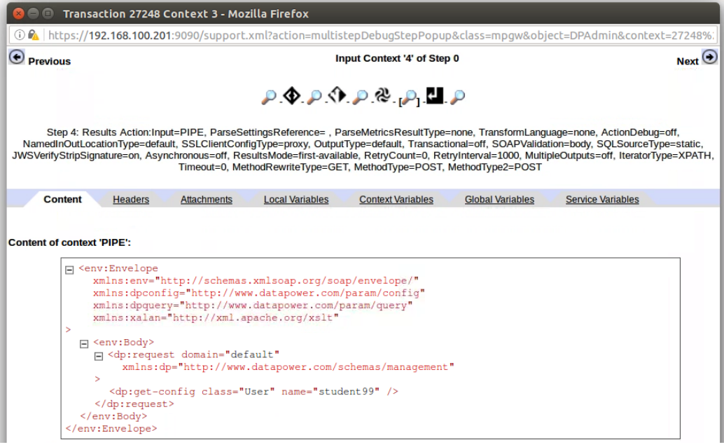
Transform creates XMI

Slide 19
XMI – Exercise Sections 2.4, 2.5
Workstation
IDG
student01_domain domain
form data
Web page with JavaScript
DPAdmin (MPGW)
default domain
XMI (SOMA & AMP) – 5550
RMI - 5554

Slide 20
End
Further slides WIP …

Slide 21
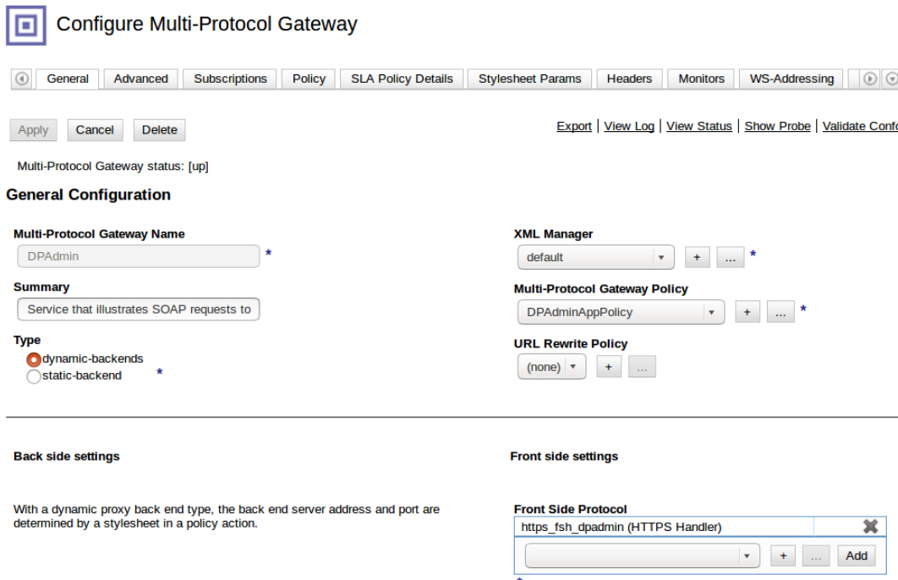
DPAdmin –Front Side Protocol

Slide 22
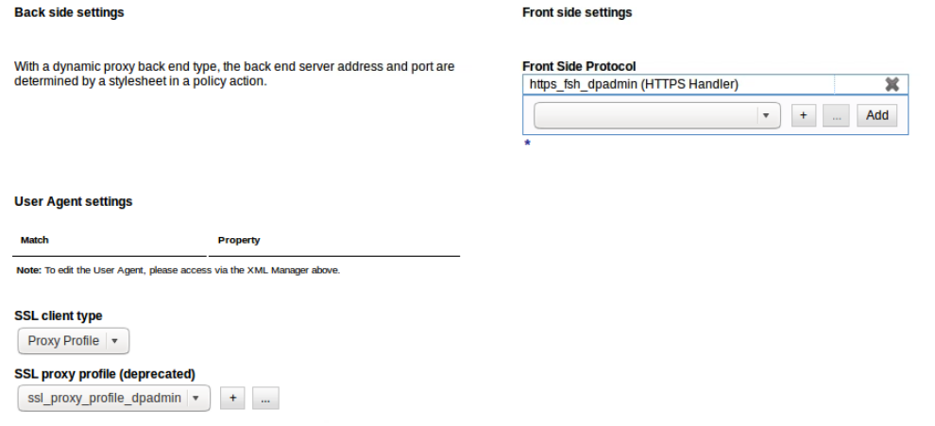
DPAdmin MPGW

Slide 23
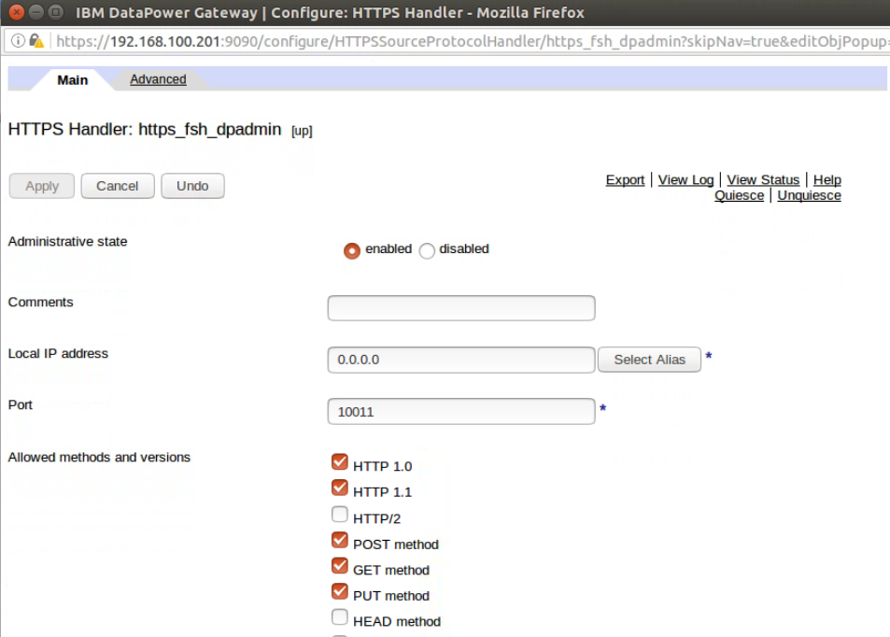
https_fsh_dpadmin

Slide 24
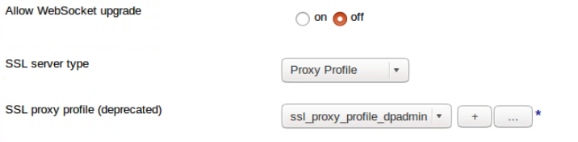
ssl_proxy_profile_dpadmin

Slide 25
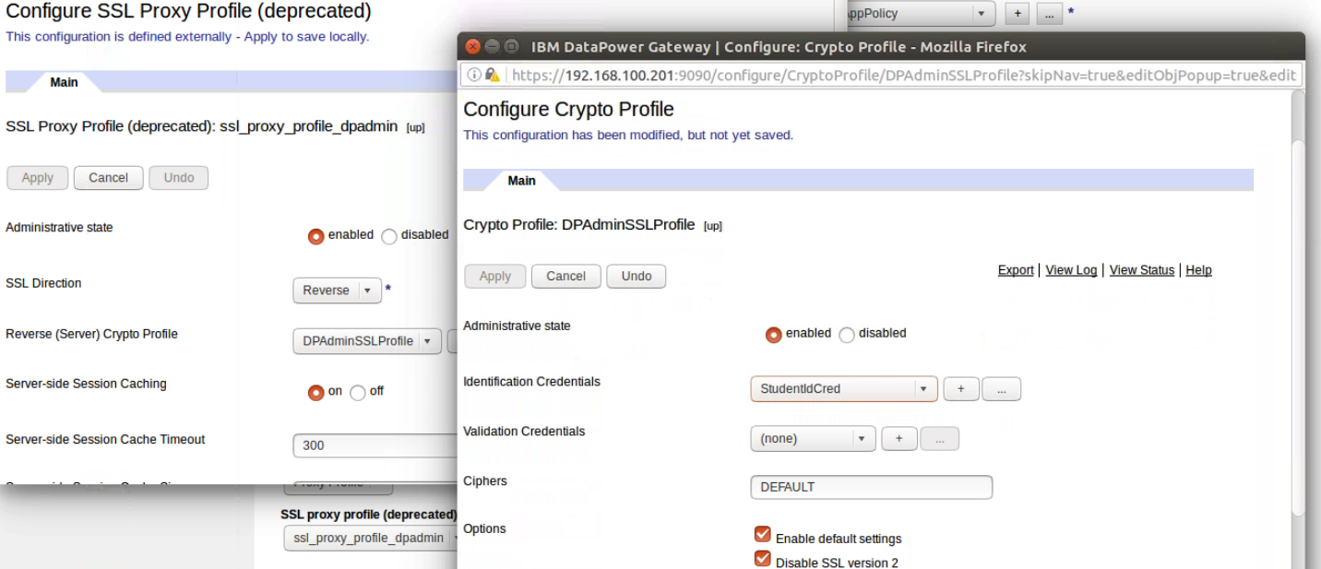
StudentIdCred
We are actually using this in the Front Handler!

Slide 26
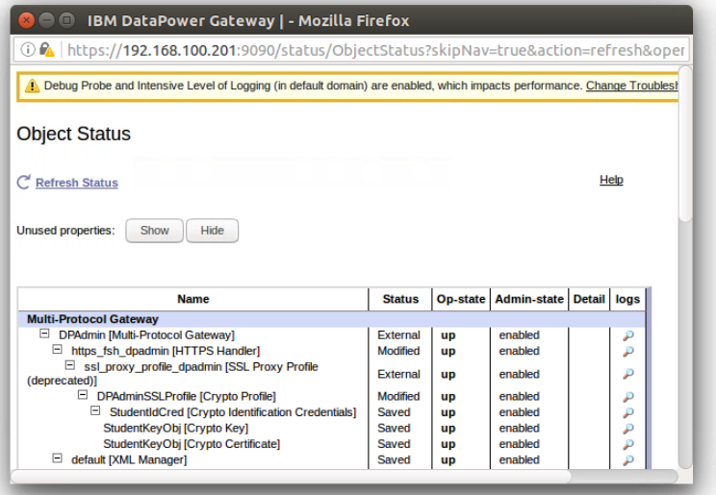
External definitions

Slide 27
XMI -
IDG
default domain
XMI (SOMA & AMP) – 5550
RMI - 5554
default domain
XMI (SOMA & AMP) – 5550
RMI - 5554

Slide 28
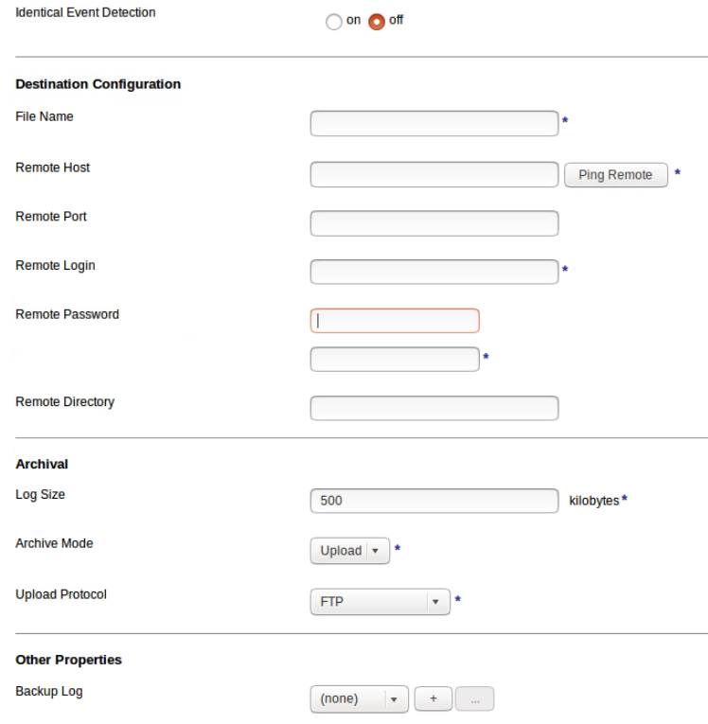
Log target Archival Upload

